Slide 1
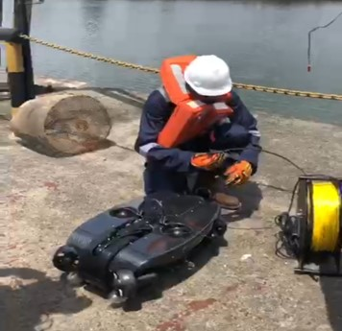
DEPLOYMENT OF ROVS FOR UNDERWATER INSPECTION OF STRUCTURES
PROBLEM STATEMENT
High cost, HSE exposures and lengthy schedules involved in diving operations makes underwater inspections difficult to execute.
Our in-house underwater inspection ROV (UVAS Equipment) can only obtain visual inspection data only and within 4m below water levels.
There are 8 underwater inspection work orders due for execution in 2024. 6 of the due WOs are located in Forcados area with challenging environmental conditions.
PROPOSED SOLUTION
Engage ROV vendor to execute underwater inspections.
Buy simple RoV systems that in house inspectors can use subsequently to perform inspections to build capability and improve availability of the inspection data.
Remote Operated Vehicles have been used in many OUs and in the industry as a proven method for underwater inspections. SPDC will benefit from deployment of RoV as previously used in some scope.
POTENTIAL BENEFIT
Value Drivers | Diving Operations | ROV
Inspection Cost | $1.7m | $0.7m (ROV purchase included) (60% savings – $1m)
Inspection Schedule | Premob only can take up 7months | Avg. of 3 wks (~80% improvement)
HSE Risk | Intolerable (zero visibility, high waves & currents) | Low (ROV is operated from vessel/platform)
Complexity | High | Simple (Easy to replicate)
EXECUTION PLAN
Technical Reviews
Selection
Deployment
CIVIL META TEAM

